Slide 1

CUSTOMER SENTIMENT ANALYSIS AND DATA REPORTING USING NLP
REVIEW 1
PRESENTED BY:
VIKASH VIJAYAN A - 21BEC1462
RAGUL D - 21BEC1625
NIRANJANA D - 21BEC1655
GUIDED BY:
LATHA P

Slide 2
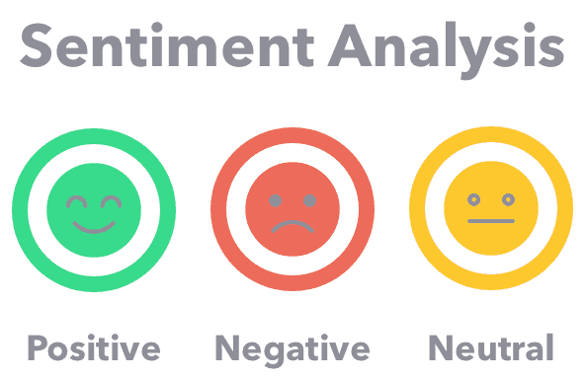

INTRODUCTION
The customer Sentiment Analysis project aims to decode the emotions and opinions expressed in customer reviews. By employing cutting-edge technologies, we seek to transform raw feedback into actionable intelligence, steering our business towards continuous improvement and heightened customer satisfaction.

Slide 3
LITERATURE REVIEW
LITERATURE NAME | ABSTRACT | PUBLISHER | AUTHOR | DATE OF PUBLICATION
A Novel Customer Perception Analysis System Using Natural Language Processing and Attribute Control Charting | This study uses sentiment analysis, topic modeling, and control charts to analyze customer reviews, identifying negative trends and key grievances. Regression analysis validates hypotheses about quality attributes affecting satisfaction. A luxury hotel case study highlights actionable insights from natural language processing and statistical tools. | IEEE | Shubham T. Kakde , Sayak Roychowdhury | 12 March 2024
Aspect-Based Sentiment Analysis for Service Industry | This study presents a two-step hybrid approach for aspect-based sentiment analysis (ABSA) of mobile app reviews, combining rule-based methods, machine learning, and fine-tuned BERT to address implicit opinions and sentiment polarity. An annotated dataset enhances customer feedback analysis. | IEEE | Afsheen Maroof , Shaukat Wasi | 8 August 2024

Slide 4
LITERATURE REVIEW
Comparative Analysis of Deep Natural Networks and Large Language Models for Aspect-Based Sentiment Analysis | Sentiment analysis, especially Aspect-Based Sentiment Analysis (ABSA), captures nuanced sentiments in e-commerce. This study evaluates DeBERTa, PaLM, and GPT-3.5-Turbo on datasets (DOTSA, MAMS, SemEval16), finding DeBERTa excels consistently while PaLM performs well across domains, highlighting ABSA's domain sensitivity and research opportunities. | IEEE | Nimra Mughal; Ghulam Mujtaba | 17 April 2024
EEBERT: An Emoji-Enhanced BERT Fine-Tuning on Amazon Product Reviews for Text Sentiment Classification | Emoji-Enhanced BERT (EEBERT) improves sentiment analysis by incorporating a Sentiment Adjustment Factor (SAF) for emoji tokenization. Achieving 97.00% accuracy and 99.21% via 5-fold cross-validation on Amazon reviews, it highlights emojis' emotional impact and enhances classification reliability. | IEEE | Hongying Zan; Kheem Parkash Dharmani | 6 September 2024

Slide 5
LITERATURE REVIEW
Data-Driven Decision-Making to Rank Products According to Online Reviews and the Interdependencies Among Product Features | This article presents a hybrid approach for product ranking, combining sentiment analysis with multicriteria decision-making. It employs association rule mining, fuzzy cognitive maps, and interval-valued intuitionistic fuzzy theory with MULTIMOORA to rank products, improving reliability and addressing feature interdependencies. Amazon mobile phone reviews validate the method. | IEEE | Jalil Heidary Dahooie; Romina Raafat | 8 November 2023
Sentiment Analysis on Feedback Data of E-commerce Products Based on NLP | This study applies NLP to analyze Amazon product reviews, using Python's NLTK for preprocessing and a regression model achieving an F1-Score of 0.87. The results highlight the model's effectiveness in classifying sentiments, offering insights to improve customer satisfaction. | IEEE | K. Sumathi, Kundhavai Santharam | June 15, 2023

Slide 6

PROBLEM STATEMENT
Understanding Customer Sentiment
To effectively analyze customer sentiment , it is crucial to discern positive and negative feedback while understanding the reasons behind these sentiments. Identifying strengths allows us to enhance positive experiences, while pinpointing areas for improvement guides strategic enhancements in services, customer interactions, and overall satisfaction.

Slide 7

OBJECTIVES
Data Collection:
The foundation of this analysis lies in collecting data from the website, reputable sources of reviews. The data encompasses crucial elements such as the publication date of reviews, the geographical location of users, and the verbatim text of the reviews themselves.These data is then sent to a data warehouse were it could be easily accesed.
2. Data Preprocessing:
Data cleaning includes handling missing data, converting text to lowercase for uniformity, and eliminating noise (such as special characters, URLs, and emojis). Spelling corrections are made, stopwords are removed, and redundant reviews are removed. To ensure clean and consistent data for analysis, the text is finally tokenised into words or phrases.

Slide 8
OBJECTIVES
3. Application of NLP Techniques:
Natural Language Processing (NLP) techniques were applied to the textual
content of the reviews to extract meaningful insights. Key NLP tasks
performed include:
Tokenization: Breaking down text into individual words or tokens.
Lemmatization: Reducing words to their base or root form to normalize variations.
Part-of-speech tagging: Identifying the grammatical components of each word in the text.
4. Cloud Automation: Using AWS (Amazon Web Services) refers to the use of various AWS services and tools to automate the deployment, management, scaling, and monitoring of cloud resources. By automating cloud processes, businesses can achieve greater efficiency, reduce human error, and improve operational scalability.
5. Dashboard Visualization:
In Power BI, a Sentiment Overview can be displayed using a chart to show the proportion of positive, negative, and neutral reviews. A Sentiment Trends Over Time line chart tracks changes in sentiment

Slide 9

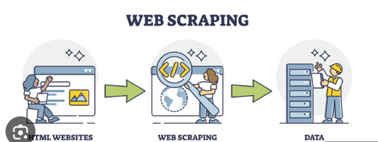
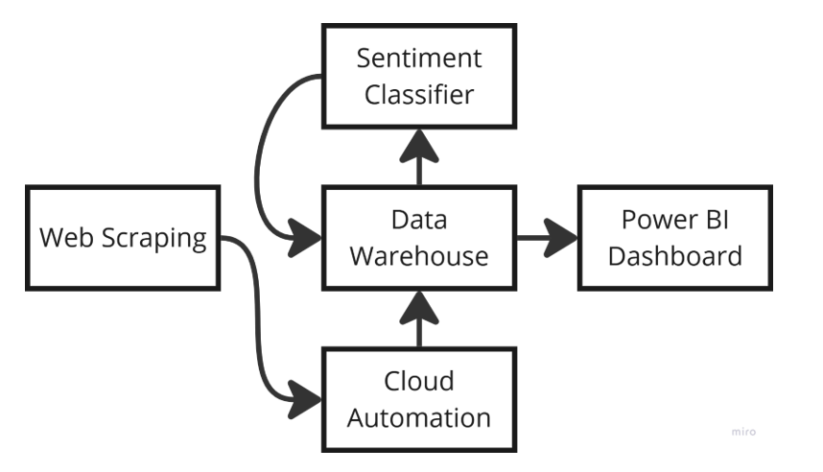

PROPOSED SYSTEM
To ensure the dynamic flow of data we have chosen a website as a source. Web Scrapping technique is used to extract the review data from the website. Then NLP algorithms are used to analyse the sentiment of customers

Slide 10

METHODOLOGY
Modules/Algorithms/Functionalities/Protocols
Data Collection Approaches (Advantages, Limitations, Potential Risks, Ethical Issues)
Data Analysis Approaches
System Model

Slide 11
RESULTS OBTAINED

Slide 12
WORK TO BE DONE

Slide 13

THANK YOU

